Slide 1


U23CS301-Data Structures
PARVATHY.K AP/AI&DS

Slide 2
Course Objectives:
PARVATHY.K AP/AI&DS
To understand the concepts of abstract data types.
To learn linear data structures – lists, stacks, and queues.
To understand sorting, searching and hashing algorithms.
To learn to apply the tree and graph structures to real world problems.

Slide 3
Course Outcomes:
PARVATHY.K AP/AI&DS
Upon completion of the course, students shall have ability to
CO1:Understand the concepts of linked lists. K2-Understand
CO2:Build stacks and queues using arrays and linked lists. K3-Apply
CO3:Perform various operations on trees K3-Apply
CO4:Write algorithms using graphs K3-Apply
CO5 :Apply sorting, searching and hashing techniques K3-Apply

Slide 4
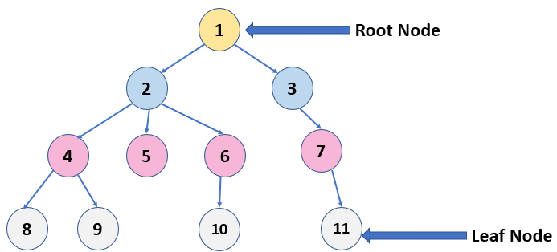

UNIT III TREES

Slide 5
Terminologies -Binary Trees: Implementation – Traversals- Expression Trees - Cousins of Binary Tree - Binary Search Trees: Construction-Insertion-Deletion – Searching-Find Min-Find Max-AVL Trees: Insertion– Deletion- Priority Queues (Heaps) Applications(Dictionary, Text Processing)

Slide 6
AVL TREE

Slide 7
AVL TREES
AVL tree is a self-balancing binary search tree in which each node maintains extra information called a balance factor whose value is either -1, 0 or +1.
AVL Tree can be defined as height balanced binary search tree in which each node is associated with a balance factor which is calculated by subtracting the height of its right sub-tree from that of its left sub-tree.

Slide 8
Balance Factor
Balance Factor = Height of Left Subtree − Height of Right Subtree
If balance factor of any node is 1, it means that the left sub-tree is one level higher than the right sub-tree.
If balance factor of any node is 0, it means that the left sub-tree and right sub-tree contain equal height.
If balance factor of any node is -1, it means that the left sub-tree is one level lower than the right sub-tree.

Slide 9
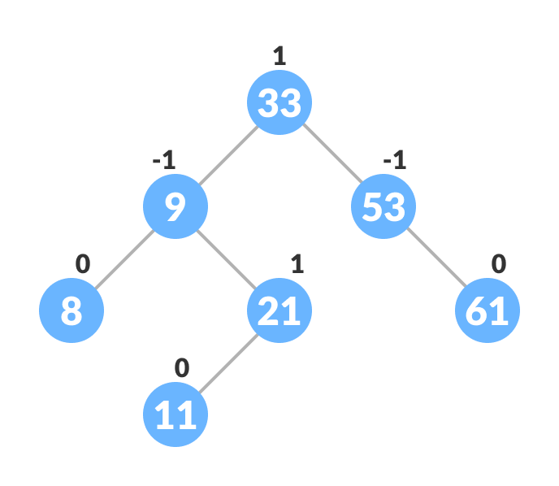

Slide 10
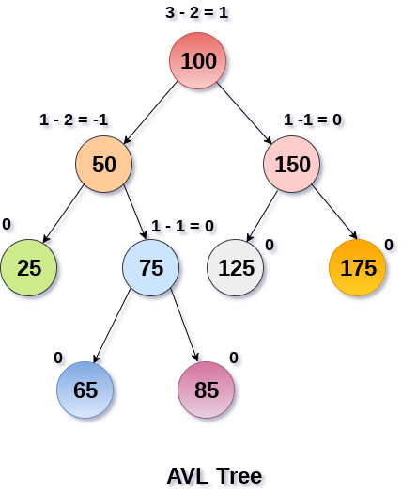

Slide 11
AVL Rotations
We perform rotation in AVL tree only in case if Balance Factor is other than -1, 0, and 1.
L L rotation: Inserted node is in the left subtree of left subtree of A.
R R rotation : Inserted node is in the right subtree of right subtree of A.
L R rotation : Inserted node is in the right subtree of left subtree of A.
R L rotation : Inserted node is in the left subtree of right subtree of A.

Slide 12
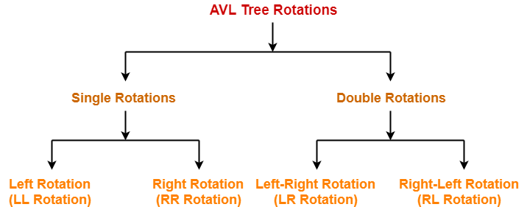

Slide 13
1. RR Rotation
When BST becomes unbalanced, due to a node is inserted into the right subtree of the right subtree of A, then we perform RR rotation, RR rotation is an clockwise rotation, which is applied on the edge below a node having balance factor -2.

Slide 14
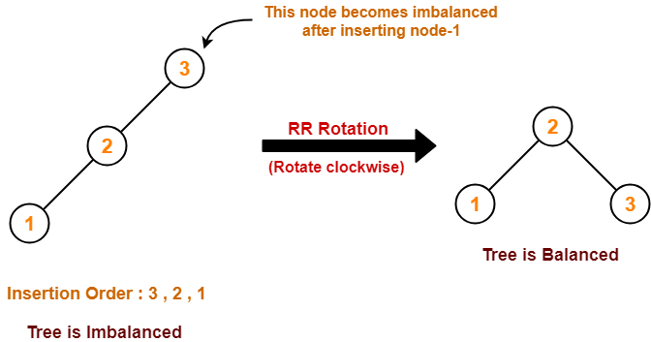

Slide 15
2. LL Rotation
When BST becomes unbalanced, due to a node is inserted into the left subtree of the left subtree of C, then we perform LL rotation, LL rotation is Anticlockwise rotation, which is applied on the edge below a node having balance factor 2.

Slide 16
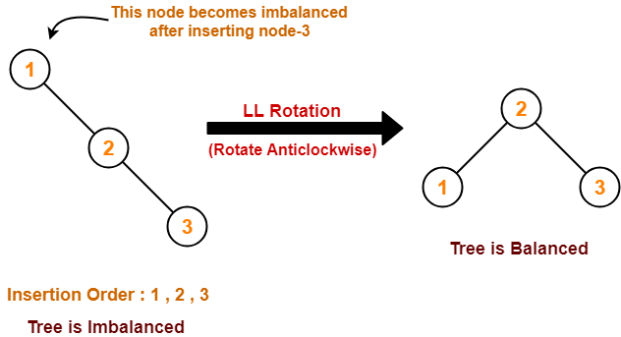

Slide 17
3. LR Rotation
Double rotations are bit tougher than single rotation which has already explained above.
LR rotation = LL rotation + RR rotation, i.e., first RR rotation is performed on subtree and then LL rotation is performed on full tree, by full tree we mean the first node from the path of inserted node whose balance factor is other than -1, 0, or 1.

Slide 18
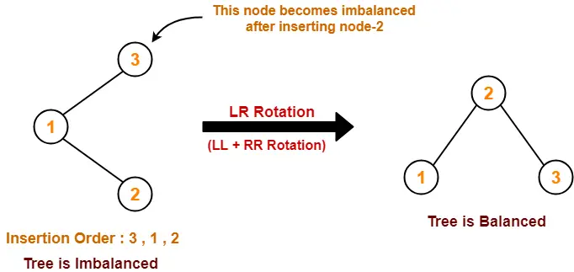

Slide 19
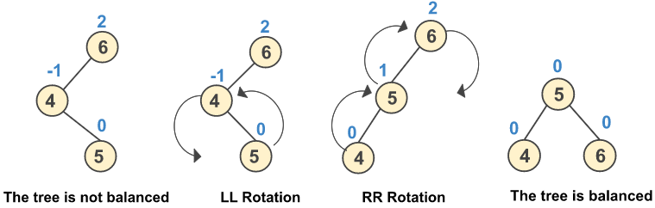

Slide 20
4. RL Rotation
R L rotation = RR rotation + LL rotation, i.e., first LL rotation is performed on subtree and then RR rotation is performed on full tree, by full tree we mean the first node from the path of inserted node whose balance factor is other than -1, 0, or 1.

Slide 21
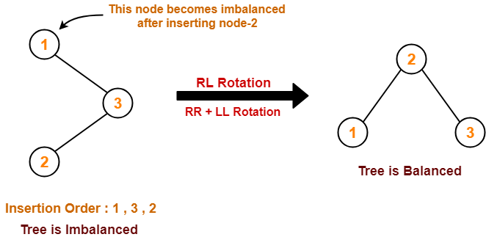

Slide 22
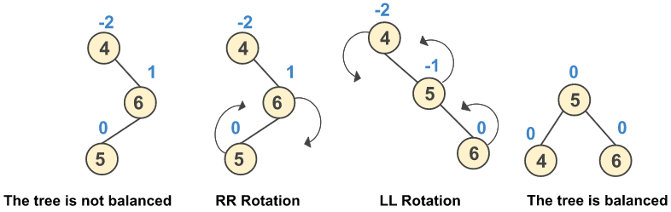

Slide 23
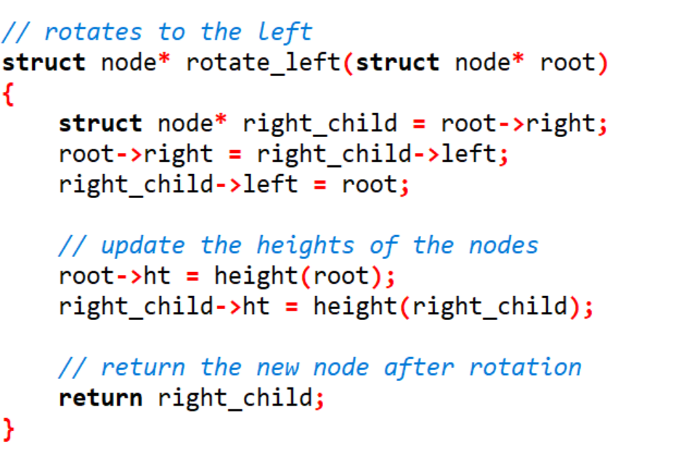

Slide 24
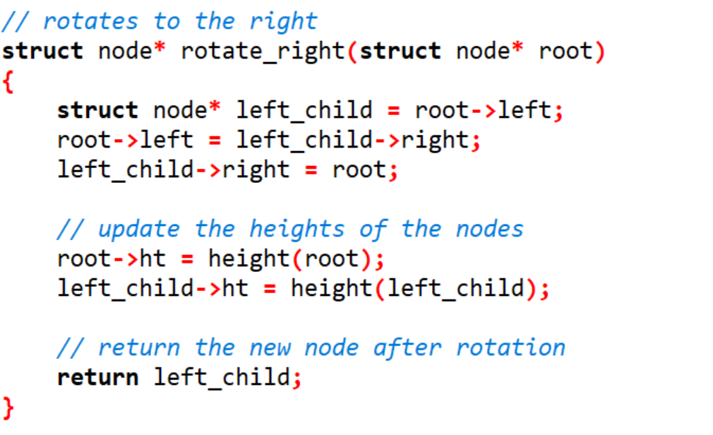

Slide 25
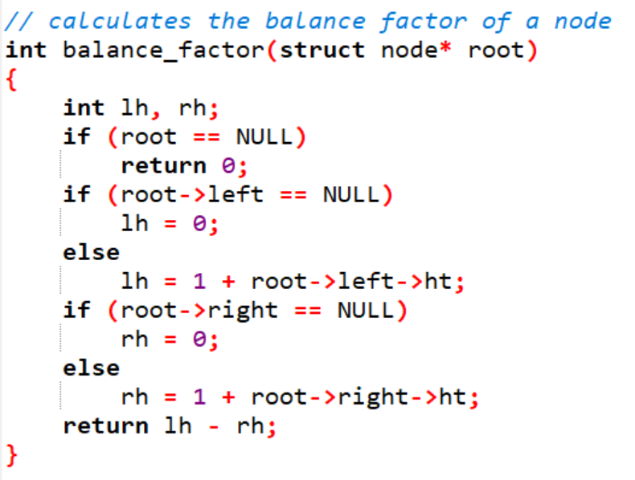

Slide 26
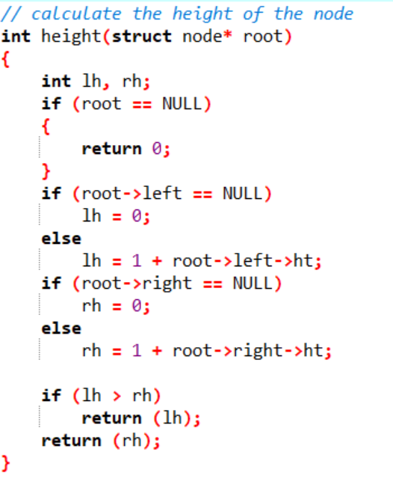

Slide 27
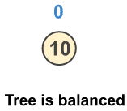
Construct an AVL tree having the following elements
10 | 15 | 20 | 9 | 5 | 16 | 17 | 8 | 6

Slide 28
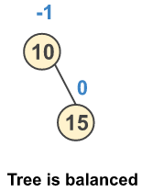
Construct an AVL tree having the following elements
10 | 15 | 20 | 9 | 5 | 16 | 17 | 8 | 6

Slide 29
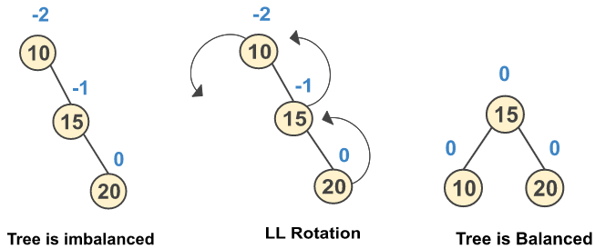
Construct an AVL tree having the following elements
10 | 15 | 20 | 9 | 5 | 16 | 17 | 8 | 6

Slide 30
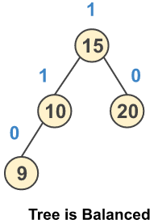
Construct an AVL tree having the following elements
10 | 15 | 20 | 9 | 5 | 16 | 17 | 8 | 6

Slide 31
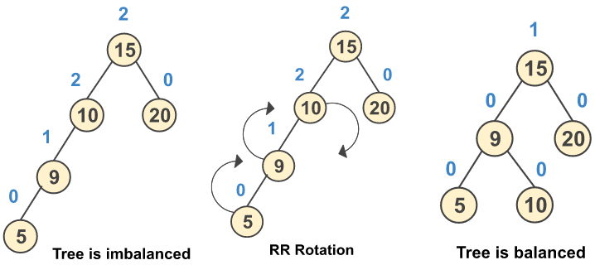
Construct an AVL tree having the following elements
10 | 15 | 20 | 9 | 5 | 16 | 17 | 8 | 6

Slide 32
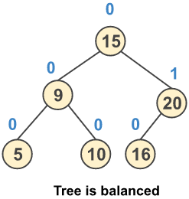
Construct an AVL tree having the following elements
10 | 15 | 20 | 9 | 5 | 16 | 17 | 8 | 6

Slide 33
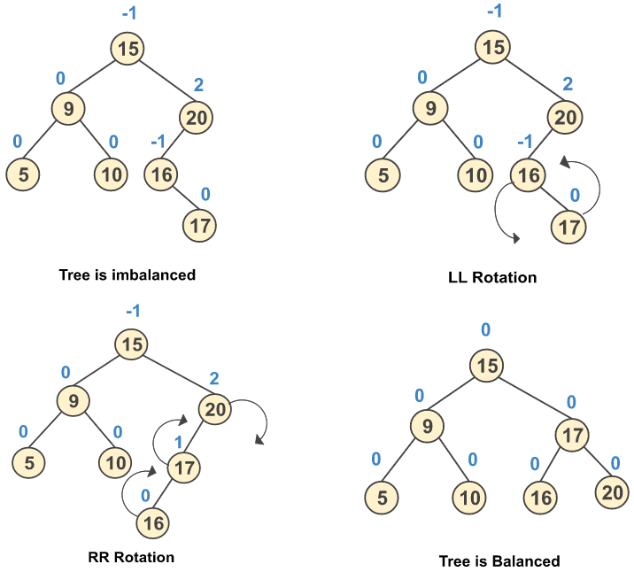
Construct an AVL tree having the following elements
10 | 15 | 20 | 9 | 5 | 16 | 17 | 8 | 6

Slide 34
Construct an AVL tree having the following elements
10 | 15 | 20 | 9 | 5 | 16 | 17 | 8 | 6

Slide 35
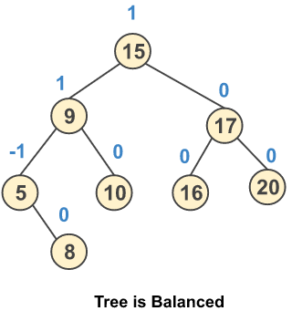
Construct an AVL tree having the following elements
10 | 15 | 20 | 9 | 5 | 16 | 17 | 8 | 6

Slide 36
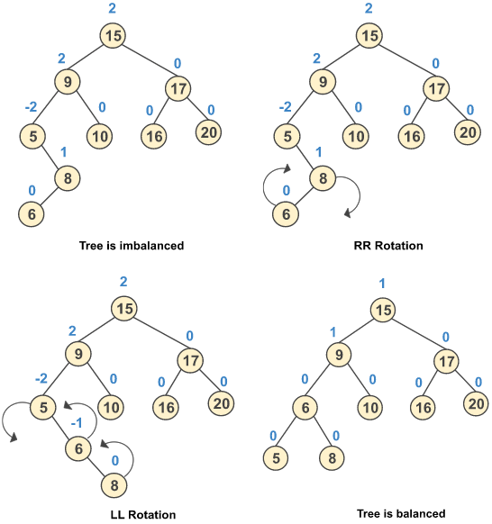
Construct an AVL tree having the following elements
10 | 15 | 20 | 9 | 5 | 16 | 17 | 8 | 6

Slide 37
Construct an AVL tree having the following elements
10 | 15 | 20 | 9 | 5 | 16 | 17 | 8 | 6

Slide 38
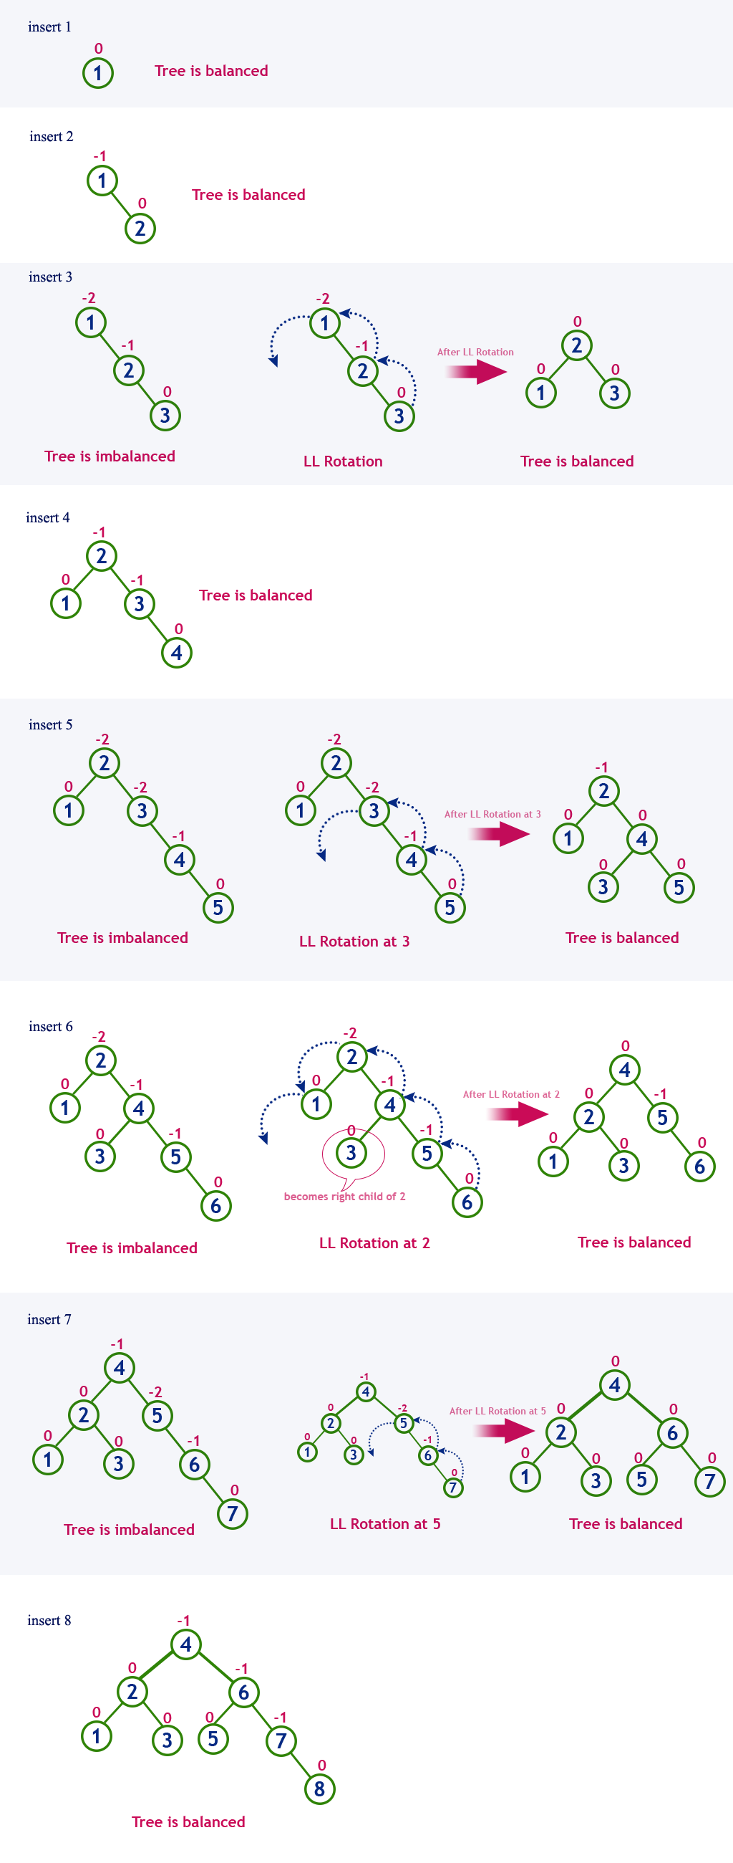
Example: Construct an AVL Tree by inserting numbers from 1 to 8.

Slide 41
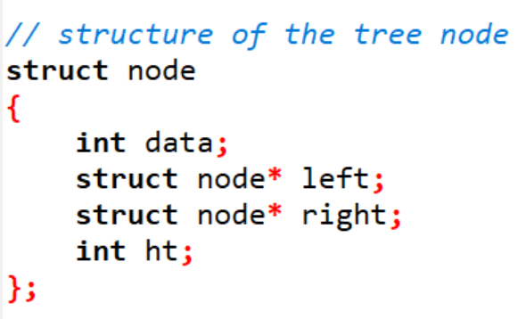

Slide 42
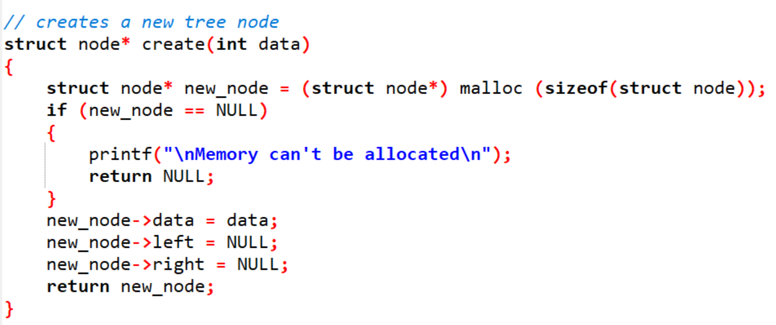

Slide 43
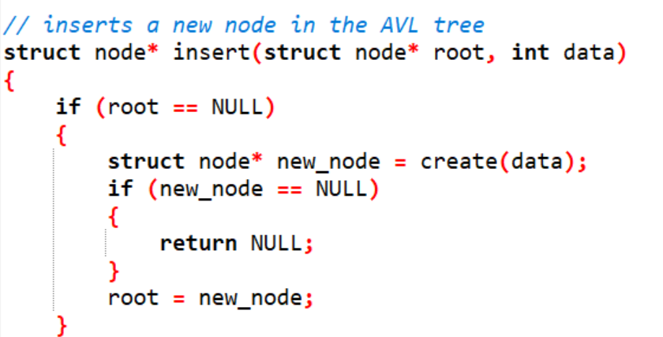
CONTD……..

Slide 44
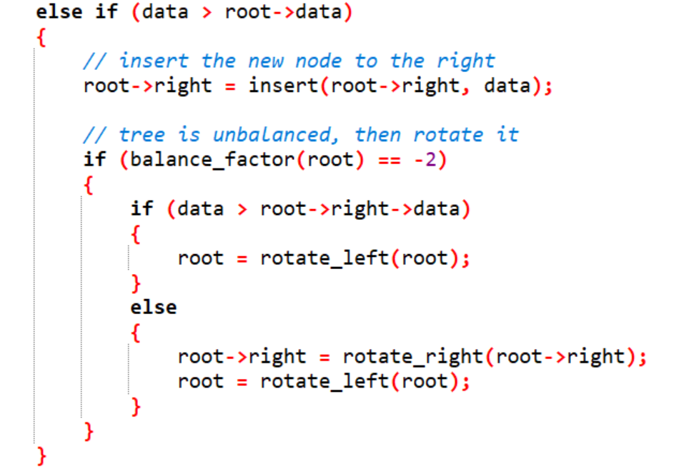
CONTD……..

Slide 45
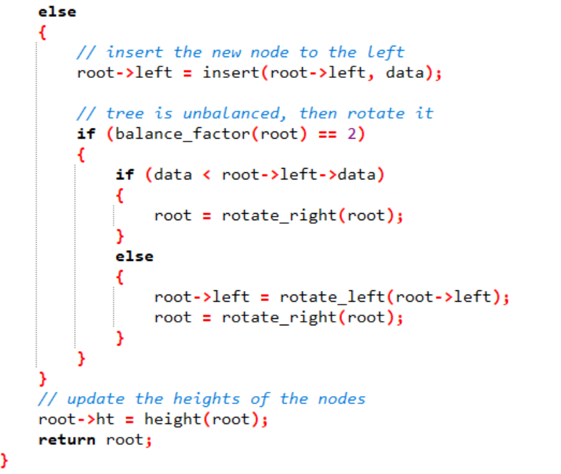

Slide 46
Deletion
Deletion of a node is similar to that of deleting a node in the binary search tree. In AVL Tree, after deleting the node we have to maintain the balanced factor again. We need to follow the given steps to delete a node in AVL Tree:
Search the element in the tree
Delete the node
There are two cases that are possible after deletion
Deleting from the right subtree
Deleting from the left subtree

Slide 47
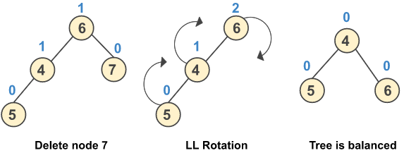
Case 1: Deleting a Node from the Right Subtree
a) Perform LL rotation when after deletion of a node the balance factor of a node changes to +2 and the balance factor of its left child is +1.

Slide 48
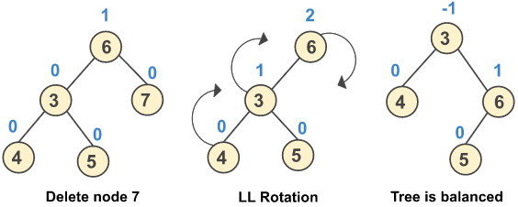
b) Perform LL rotation when after deletion of a node the balance factor of a node changes to +2 and the balance factor of its left child is 0.

Slide 49
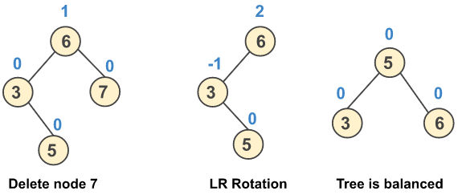
c) Perform LR rotation when after deletion of a node the balance factor of a node changes to +2 and the balance factor of its left child is -1.

Slide 50
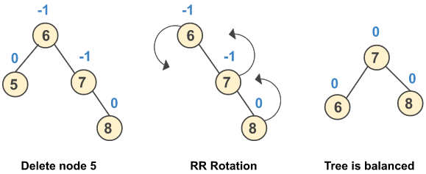
Case 2: Deleting a Node from the Left Subtree
a) Perform RR rotation when after deletion of a node the balance factor of a node changes to -2 and the balance factor of its left child is -1.

Slide 51
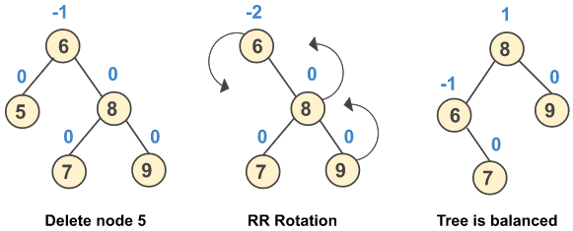
b) Perform RR rotation when after deletion of a node the balance factor of a node changes to -2 and the balance factor of its left child is 0.

Slide 52
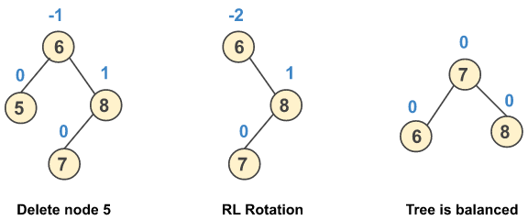
c) Perform RL rotation when after deletion of a node the balance factor of a node changes to -2 and the balance factor of its left child is 1.

Slide 53
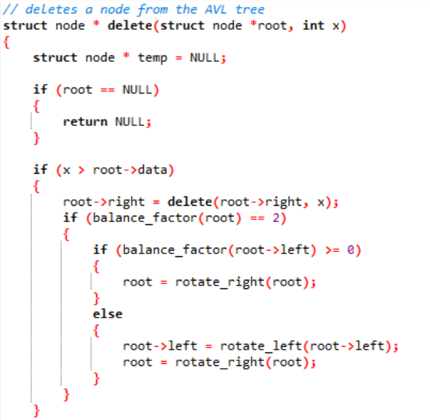
CONTD……..

Slide 54
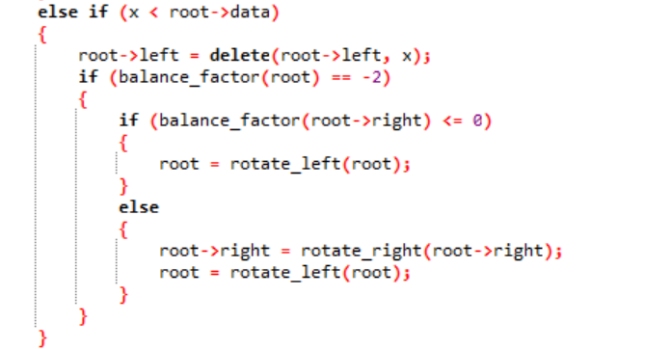
CONTD……..

Slide 55
